Slide 1
Who wants to please The Father?
Stop worrying about what the world thinks of you, worry about what YHVH thinks of you!
Stop thinking about what the world can give you, think about what YHVH can give you!
Stop building kingdoms that reflect the world, but rather build that which reflects YHVH!
Stop thinking what about the loses, but think about the gains in YHVH!
Stop putting ourselves 1st, instead put YHVH 1st and foremost!

Slide 2
Who wants to please The Father?
And when the people complained, it displeased YHVH: and YHVH heard it; and his anger was kindled; and the fire of YHVH burnt among them, and consumed them that were in the uttermost parts of the camp. ² And the people cried unto Moses; and when Moses prayed unto YHVH, the fire was quenched. ³ And he called the name of the place Taberah: because the fire of YHVH burnt among them.⁴ And the mixt multitude that was among them fell a lusting: and the children of Israel also wept again, and said, Who shall give us flesh to eat? ⁵ We remember the fish, which we did eat in Egypt freely; the cucumbers, and the melons, and the leeks, and the onions, and the garlick: ⁶ but now our soul is dried away: there is nothing at all, beside this manna, before our eyes. ⁷ And the manna was as coriander seed, and the colour thereof as the colour of bdellium. ⁸ And the people went about, and gathered it, and ground it in mills, or beat it in a mortar, and baked it in pans, and made cakes of it: and the taste of it was as the taste of fresh oil. ⁹ And when the dew fell upon the camp in the night, the manna fell upon it. ¹⁰ Then Moses heard the people weep throughout their families, every man in the door of his tent: and the anger of YHVH was kindled greatly; Moses also was displeased. Numbers 11:1-10

Slide 3
Who wants to please The Father?
Read the bible with focus and intent – you will see pattern after pattern…
One such pattern is YHVH bringing His people up and out of Egypt.
Another sad pattern is the continued disobedience of Israel as a nation.
Another encouraging pattern is even amongst all the disobedience and complaining is a remnant who remain loyal to YHVH.
Great news – YHVH will remain faithful to the remnant… those who please Him through heart circumcision, even if they have been led astray by false shepherds.

Slide 4
Who wants to please The Father?
Woe be unto the pastors that destroy and scatter the sheep of my pasture! saith YHVH. ² Therefore thus saith YHVH God of Israel against the pastors that feed my people; Ye have scattered my flock, and driven them away, and have not visited them: behold, I will visit upon you the evil of your doings, saith YHVH. ³ And I will gather the remnant of my flock out of all countries whither I have driven them, and will bring them again to their folds; and they shall be fruitful and increase. ⁴ And I will set up shepherds over them which shall feed them: and they shall fear no more, nor be dismayed, neither shall they be lacking, saith YHVH.⁵ Behold, the days come, saith the Lord, that I will raise unto David a righteous Branch, and a King shall reign and prosper, and shall execute judgment and justice in the earth. ⁶ In his days Judah shall be saved, and Israel shall dwell safely: and this is his name whereby he shall be called, YHVH our righteousness. Jeremiah 23:1-6

Slide 5
Who wants to please The Father?
Intentionally or unintentionally many Pastors, Priests, Teachers, Leaders have led the Children of Israel astray.
Having been brought up on a sheep farm, I know the importance of good animal husbandry – shepherding. Protecting the flock, in all areas of welfare.
What a warning and statement: Woe be unto the pastors that destroy and scatter the sheep of my pasture! saith YHVH. This has been a problem down through the ages…
For there are many unruly and vain talkers and deceivers, specially they of the circumcision: ¹¹ whose mouths must be stopped, who subvert whole houses, teaching things which they ought not, for filthy lucre’s sake. Titus 1:10-11

Slide 6
Who wants to please The Father?
But there were false prophets also among the people, even as there shall be false teachers among you, who privily shall bring in damnable heresies, even denying the Lord that bought them, and bring upon themselves swift destruction. ² And many shall follow their pernicious ways; by reason of whom the way of truth shall be evil spoken of. ³ And through covetousness shall they with feigned [fabricated, fictitious, artificial] words make merchandise of you: 2 Peter 2:1-3a
Destroy and scatter… that is what false prophets, false teachers, do. Yet we must also realise that sheep will destroy and scatter themselves, even if a good shepherd is in charge.
Yeshua is the perfect Shepherd but we see…

Slide 7
Who wants to please The Father?
Many therefore of his disciples, when they had heard this, said, This is an hard saying; who can hear it? ⁶¹ When Yeshua knew in himself that his disciples murmured at it, he said unto them, Doth this offend you? ⁶² What and if ye shall see the Son of man ascend up where he was before? ⁶³ It is the spirit that quickeneth; the flesh profiteth nothing: the words that I speak unto you, they are spirit, and they are life. ⁶⁴ But there are some of you that believe not. For Yeshua knew from the beginning who they were that believed not, and who should betray him. ⁶⁵ And he said, Therefore said I unto you, that no man can come unto me, except it were given unto him of my Father. ⁶⁶ From that time many of his disciples went back, and walked no more with him. John 6:60-66
Not every lost sheep can be blamed onto bad shepherds. In fact most of the blame is due to decisions people make by themselves.
Yeshua had some strong words about doing things our own way…

Slide 8
Who wants to please The Father?
Verily, verily, I say unto you, He that entereth not by the door into the sheepfold, but climbeth up some other way, the same is a thief and a robber. ² But he that entereth in by the door is the shepherd of the sheep. ³ To him the porter openeth; and the sheep hear his voice: and he calleth his own sheep by name, and leadeth them out. ⁴ And when he putteth forth his own sheep, he goeth before them, and the sheep follow him: for they know his voice. ⁵ And a stranger will they not follow, but will flee from him: for they know not the voice of strangers. ⁶ This parable spake Yeshua unto them: but they understood not what things they were which he spake unto them. ⁷ Then said Yeshua unto them again, Verily, verily, I say unto you, I am the door of the sheep…

Slide 9
Who wants to please The Father?
⁸ All that ever came before me are thieves and robbers: but the sheep did not hear them. ⁹ I am the door: by me if any man enter in, he shall be saved, and shall go in and out, and find pasture. ¹⁰ The thief cometh not, but for to steal, and to kill, and to destroy: I am come that they might have life, and that they might have it more abundantly. ¹¹ I am the good shepherd: the good shepherd giveth his life for the sheep. ¹² But he that is an hireling, and not the shepherd, whose own the sheep are not, seeth the wolf coming, and leaveth the sheep, and fleeth: and the wolf catcheth them, and scattereth the sheep. ¹³ The hireling fleeth, because he is an hireling, and careth not for the sheep. ¹⁴ I am the good shepherd, and know my sheep, and am known of mine…

Slide 10
Who wants to please The Father?
¹⁵ As the Father knoweth me, even so know I the Father: and I lay down my life for the sheep. ¹⁶ And other sheep I have, which are not of this fold: them also I must bring, and they shall hear my voice; and there shall be one fold, and one shepherd. ¹⁷ Therefore doth my Father love me, because I lay down my life, that I might take it again. ¹⁸ No man taketh it from me, but I lay it down of myself. I have power to lay it down, and I have power to take it again. This commandment have I received of my Father. John 10:1-18
Shepherds and sheep have a responsibility…
The good news is [we need plenty of that] despite the interference of questionable shepherds, if we stay faithful to Yeshua through teshuvah - embrace His instruction YHVH will gather us from:

Slide 11
Who wants to please The Father?
³ And I will gather the remnant of my flock out of all countries whither I have driven them, and will bring them again to their folds; and they shall be fruitful and increase. ⁴ And I will set up shepherds over them which shall feed them: and they shall fear no more, nor be dismayed, neither shall they be lacking, saith YHVH. Jeremiah 23:3-4
The Father Himself will gather His people from whence they have been scattered. He will appoint shepherds, not hirelings who will care for them. Shepherds who make sure the flock is eating from healthy pastures. Shepherds who stay true to the line of David, obeying the instructions of the Father. Shepherds who point the way to our true, and faithful Shepherd – Yeshua The Messiah… our One and only Saviour!...

Slide 12
therefore, O ye shepherds, hear the word of the Lord; ¹⁰ Thus saith the Lord God; Behold, I am against the shepherds; and I will require my flock at their hand, and cause them to cease from feeding the flock; neither shall the shepherds feed themselves any more; for I will deliver my flock from their mouth, that they may not be meat for them.¹¹ For thus saith the Lord God; Behold, I, even I, will both search my sheep, and seek them out. ¹² As a shepherd seeketh out his flock in the day that he is among his sheep that are scattered; so will I seek out my sheep, and will deliver them out of all places where they have been scattered in the cloudy and dark day. ¹³ And I will bring them out from the people, and gather them from the countries, and will bring them to their own land, and feed them upon the mountains of Israel by the rivers, and in all the inhabited places of the country. Ezekiel 34:9-13

Slide 13
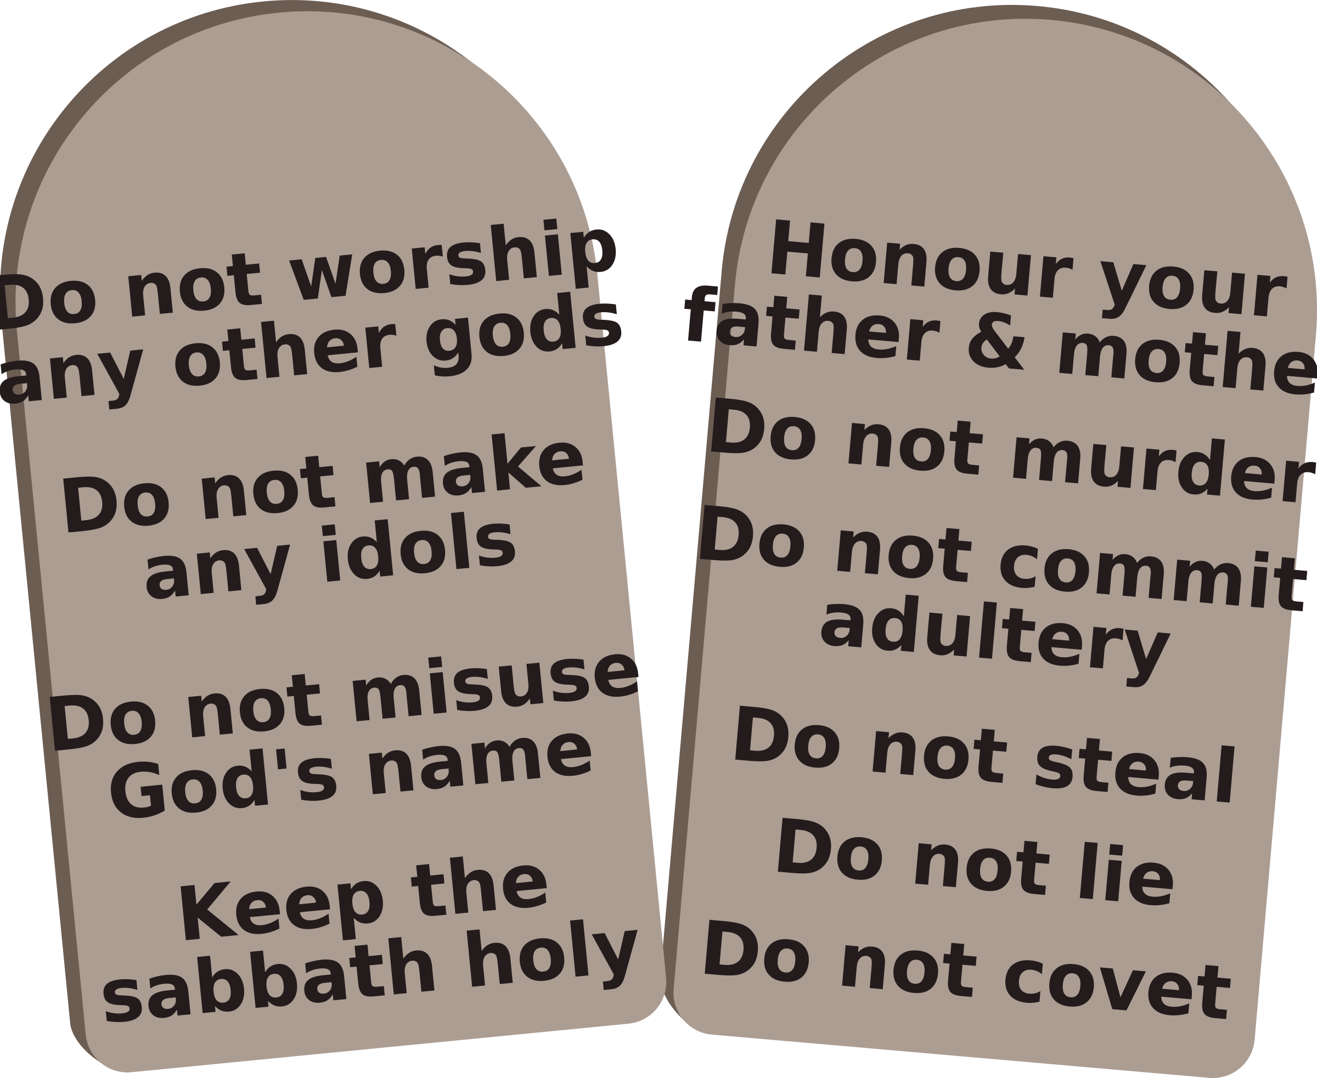
Who wants to please The Father?
Who wants to please The Father? All children of Israel should… as
We serve a wonderful God, as there is no God like the God of Israel and no nation like the nation of Israel.

