Slide 1
Decisions…
Which token will you choose? This is the question we are addressing today…
As the waters of life become more muddied – decisions become harder to make…

Slide 2
decisions
And if it seem evil unto you to serve yhvh, choose you this day whom ye will serve; whether the gods which your fathers served that were on the other side of the flood, or the gods of the Amorites, in whose land ye dwell: but as for me and my house, we will serve yhvh. Joshua 24:15
This passage of scripture is very relevant no matter what choices are presented to you…
And God said, Let there be lights in the firmament of the heaven to divide the day from the night; and let them be for signs, and for seasons, and for days, and years: Genesis 1:14
And it shall come to pass, if they will not believe thee, neither hearken to the voice of the first sign, that they will believe the voice of the latter sign. ⁹ And it shall come to pass, if they will not believe also these two signs, neither hearken unto thy voice, that thou shalt take of the water of the river, and pour it upon the dry land: and the water which thou takest out of the river shall become blood upon the dry land. Exodus 4:8-9
Sign/Oth אוׄת = Evidence, Mark, Ensign, flag, token…
And I will put a division between my people and thy people: tomorrow shall this sign be. Exodus 8:23
Division/P’duth פְדֻת = redemption, redeem, deliverance, preserve… @ Isaiah 50:2…

Slide 3
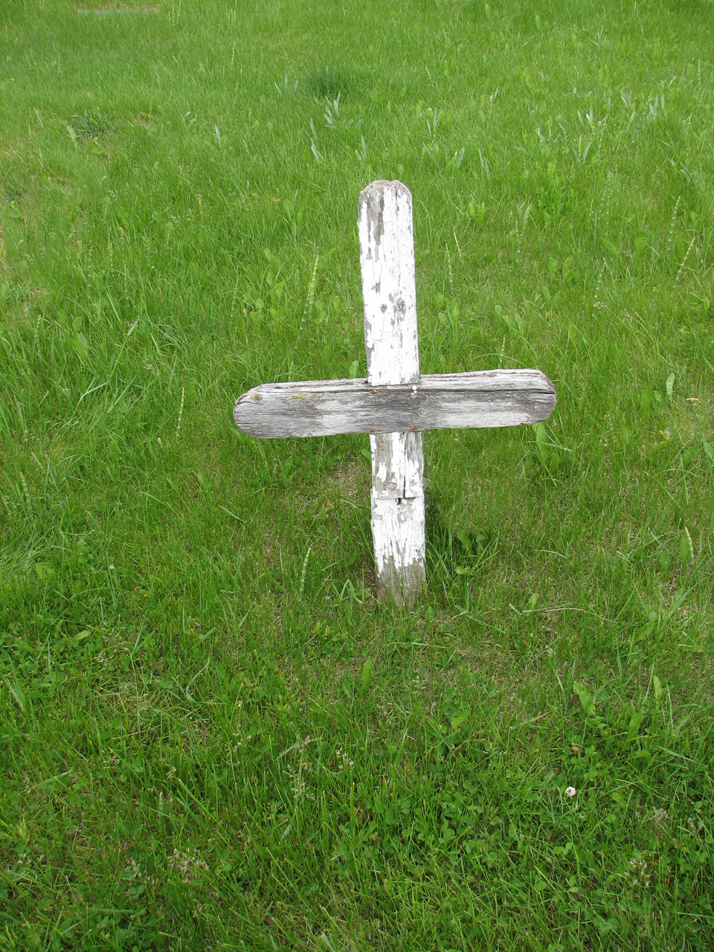
Decisions…
So far, we have seen that a sign from yhvh has significant meaning/s for his people…
We see the connection between division, [deliverance, redemption and preservation] and the word sign. So let’s take a closer look between these two connections, and what it means for us today and beyond…
A well known sign…

Slide 4
Decisions…
The signs we should be seeking are those that tell us we are indeed children of biblical israel, safe in the hand of our father.
So let’s take this one step further. In trying to make a point - imagine our creator is looking down upon us searching for signs, that tell him we are his peculiar people…
What do you believe he would be looking for? I suggest a few stand outs…
Thou shalt have no other gods before me. ⁴ Thou shalt not make unto thee any graven image, or any likeness of any thing that is in heaven above, or that is in the earth beneath, or that is in the water under the earth: ⁵ thou shalt not bow down thyself to them, nor serve them: for I yhvh thy God am a jealous God, visiting the iniquity of the fathers upon the children unto the third and fourth generation of them that hate me; ⁶ and shewing mercy unto thousands of them that love me, and keep my commandments. ⁷ Thou shalt not take the name of yhvh thy God in vain; for yhvh will not hold him guiltless that taketh his name in vain. ⁸ Remember the sabbath day, to keep it holy. ⁹ Six days shalt thou labour, and do all thy work: ¹⁰ but the seventh day is the sabbath of yhvh thy God: in it thou shalt not do any work, thou, nor thy son, nor thy daughter, thy manservant, nor thy maidservant, nor thy cattle, nor thy stranger that is within thy gates: ¹¹ for in six days yhvh made heaven and earth, the sea, and all that in them is, and rested the seventh day: wherefore yhvh blessed the sabbath day, and hallowed it…

Slide 5
decisions
¹² Honour thy father and thy mother: that thy days may be long upon the land which yhvh thy God giveth thee.
¹³ Thou shalt not kill.
¹⁴ Thou shalt not commit adultery.
¹⁵ Thou shalt not steal.
¹⁶ Thou shalt not bear false witness against thy neighbour.
¹⁷ Thou shalt not covet thy neighbour’s house, thou shalt not covet thy neighbour’s wife, nor his manservant, nor his maidservant, nor his ox, nor his ass, nor any thing that is thy neighbour’s. exodus 20:1-17
Question – if these were signs to determine your faithfulness, how are you going?
The 10 words or commandments are the very foundation for the children of israel to live by. Yet we find people wanting to move beyond these foundations and begin looking for signs to scratch itching ears…
For the season will come when they will not endure sound doctrine; but after their own lusts shall they heap to themselves teachers, who tickle their ears; ⁴ and they shall turn away their ears from the truth, and shall be turned unto fiction. 2 Timothy 4:3-4

Slide 6
decisions
If we are led away through stories of fiction, false claims, and unbiblical doctrine – we will not bear witness to the signs our father is looking for…
I find yeshua’s discussion with some characters intriguing:
A wicked and adulterous generation seeketh after a sign; and there shall no sign be given unto it, but the sign of the prophet Jonas. And he left them, and departed. Matthew 16:4
Wicked/poneros = evil, hurtful, malicious, mischievous…
Sign/semion = token, mark, evidence… the Greek equivalent to oth
So we see there are wicked signs that are not pleasing to yeshua - yhvh…
wicked & adulteress are teamed up here – meaning a people who seek signs outside of those given by yhvh, and yeshua – signs that tickle itching ears. You would think the sign of Jonah – messiah resurrected would have been a reasonable sign – but they wanted signs according to their adulteress ways…
We have to be careful, that we don’t not only ask for such wicked signs, but that we don’t follow signs some claim to be from yhvh, but are not.
But in vain they do worship me, teaching for doctrines the commandments of men. Matthew 15:9

Slide 7
Decisions…
Is it possible that many children of israel are seeking signs that are not of the father? There is a sign between yhvh and his people – what could that possibly be?...
Moreover also I gave them my sabbaths, to be a sign between me and them, that they might know that I am yhvh that sanctify them. Ezekiel 20:12
So would our father be looking to see if we keep his instructions – especially his sabbaths…
Would it be probable that one of the signs our father would be looking for from us, actually be us looking for signs from him? How are we doing with that?...
It is so easy to get caught up in the wrong signs:
and seduceth them that dwell on the earth by the means of those signs which he had power to do in the sight of the beast; saying to them that dwell on the earth, that they should make an image to the beast, which had the wound by a sword, and did live. Revelation 13:14
For they are the spirits of devils, working signs, which go forth unto the kings of the earth and of the whole world, to gather them to the battle of that great day of God Almighty. Revelation 16:14

Slide 8
Decisions…
And the beast was taken, and with him the false prophet that wrought signs before him, with which he deceived them that had received the mark of the beast, and them that worshipped his image. These both were cast alive into a lake of fire burning with brimstone. Revelation 19:20
I believe it is so important to be wearing the signs of our heavenly father in this day and age… not so much for him to recognize us, but for us to draw closer to him, and have the confidence we are his peculiar people…
Now therefore, if ye will obey my voice indeed, and keep my covenant, then ye shall be a peculiar treasure unto me above all people: for all the earth is mine: exodus 19:5
For thou art an holy people unto the Lord thy God, and the Lord hath chosen thee to be a peculiar people unto himself, above all the nations that are upon the earth. Deuteronomy 14:2
who gave himself for us, that he might redeem us from all iniquity, and purify unto himself a peculiar people, zealous of good works. Titus 2:14
Suggest good works are a sign our father is looking for – a sign both Christianity and judism wear pretty well… Baruch hashem. So the decision making process continues – which token/sign will you choose to display?? Because remember in your choice…
There is no god like the god of israel, and no nation like israel…

