Slide 1
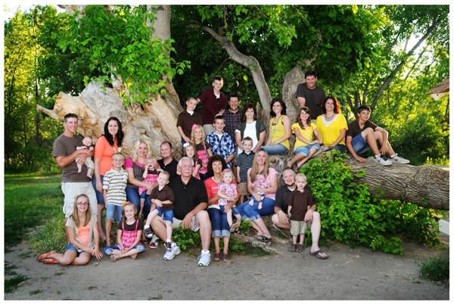
Generations – Taldot תולדות
Genesis 25:19-28. “These are the generations…
We hear and read: The God of Abraham, Isaac and Jacob…

Slide 2
Generations
The God of Abraham, Isaac and Jacob…
The number 3 is in play… Isaac being in the middle.
Isaac takes up little space in the Scriptures – much Like Yeshua. The focus is often on those before, and after him.
So what about Isaac’s father – Abraham? Do we witness a pattern that continues through the twin birth of Esau and Jacob?
Abraham was chosen by YHVH to go forth and leave his family, country etc. A little later [Genesis 14:13] we are told Abraham was called a Hebrew.
Hebrew/Ibree עׅבֽרִי Root meaning: Move to the other side, end up in a different condition.
So we have Abraham – the 1st Hebrew – 2 peoples from our Heavenly Father – Hebrews & non Hebrews.

Slide 3
Generations.
We know Abraham had 2 sons: Ishmael, and Isaac. Ishmael came about through the so-called wisdom of man – a mixture of Hebrew and Egyptian [world].
YHVH made a sovereign choice, and along came Isaac/Yitzchaq – perhaps the 1st pure Hebrew baby.
In fact Romans 9:1-8 has this to say regarding biblical lineage according to our heavenly Father:
The sovereign choice is Isaac – and guess what. It is a lineage of promise not flesh.
Physical genealogy, birthright, bloodlines, breeding establishes your earthly identity but not your spiritual identity.
Jews pay attention! Being born a Jew does not guarantee your passage into spending eternity with your Creator.
Non Jew pay attention!! Being labelled a Catholic, Protestant, Baptist… does not guarantee you a passage either.

Slide 4
Generations.
¹² But as many as received Him, to them He gave the right to become children of God, even to those who believe in His name, ¹³ who were born, not of blood nor of the will of the flesh nor of the will of man, but of God. John 1:12-13 [NASB]
The will of man, always usurps the will of YHVH. It’s not what man thinks is right, and just – but what YHVH promises to be right, and just that matters.
Hebrew is a term meaning to change direction. The term Hebrew gives identity to the Physical and the Spiritual. The Hebrew foundations are Torah and the Word of YHVH = the way of life. Leave these aside and trouble crouches at the door.
Now let’s move onto Isaac and Rebekah – similar event, but with a major difference. Esau and Jacob had the same Dad and Mum – in fact were twins. Trouble was once again just around the corner.

Slide 5
Generations.
²³ The Lord said to her, “Two nations are in your womb; And two peoples will be separated from your body; And one people shall be stronger than the other; And the older shall serve the younger.” Genesis 25:23
2 Nations - 2 different world views would result. Esau grew up to be a hunter. Jacob, a peaceful man dwelt in tents.
²⁷ When the boys grew up, Esau became a skillful hunter, a man of the field, but Jacob was a peaceful man, living in tents. ²⁸ Now Isaac loved Esau, because he had a taste for game, but Rebekah loved Jacob. Genesis 25:27-28
Nimrod was the only other character to be named a hunter in the bible. Considering this let us look at how Hirsch translates verse 28.
“Yitzchak loved Esav, because he was a hunter also with his mouth, but Rivkah loved Ya’akov.” [The Hirsch Chumash – Sefer Bereshis]
Hunter/Tzayid צַיִד Trap, execute a planned act, snare, prey.

Slide 6
Generations.
Esau was a man of action – perhaps we could say a man of the world, liked to dominate, and have his own way. Isaac seemed impressed with his hunting tales etc. After all he was Isaacs favorite. Esau could have been one to trap people with flamboyance and words, enticing the innocent and foolish @ 2 Timothy 3:1-7
Jacob a peaceful man living in tents…
Peaceful/Tam תׇמ = complete, blameless, guiltless, whole.
It appears Jacob/Ya’cov was one who was an introvert, keeping much to himself, even perhaps a son Rebekah thought she had to protect…
Within these events we witness the complexities of life. We witness the tree of good and evil. We witness Cain and Abel. We witness Egypt and Israel. We witness ourselves…
The question is:

Slide 7
Generations.
Do we want to sell our birthright for a lentil stew?
Are we heeding the instructions of our Father, or the words of false prophets?
Are we attracted to the flamboyant charismatic, with enticing words, and false promises?
Or are we attracted to:
Isaiah 53:1-12.
Indeed there is no God like our God…

