Slide 1
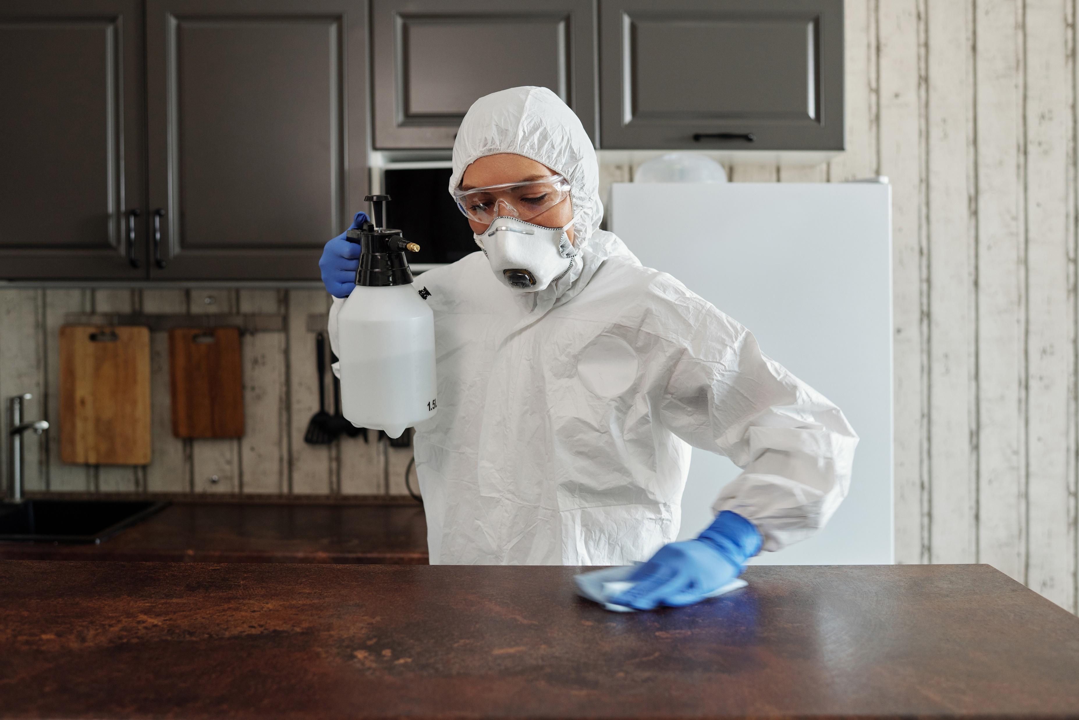
Metzora – infected one
In this day and age, much is spoken about – infections etc.
Do we need to be worried about infections… this is the ?

Slide 2
Metzora…
³⁴ When ye be come into the land of Canaan, which I give to you for a possession, and I put the plague of tzara’at in a house of the land of your possession; ³⁵ And he that owneth the house shall come and tell the priest, saying, It seemeth to me there is as it were a plague in the house:³⁶ Then the priest shall command that they empty the house, before the priest go into it to see the plague, that all that is in the house be not made unclean: and afterward the priest shall go in to see the house: ³⁷ And he shall look on the plague, and, behold, if the plague be in the walls of the house with hollow strakes, greenish or reddish, which in sight are lower than the wall; ³⁸ Then the priest shall go out of the house to the door of the house, and shut up the house seven days: ³⁹ And the priest shall come again the seventh day, and shall look: and, behold, if the plague be spread in the walls of the house; ⁴⁰ Then the priest shall command that they take away the stones in which the plague is, and they shall cast them into an unclean place without the city: ⁴¹ And he shall cause the house to be scraped within round about, and they shall pour out the dust that they scrape off without the city into an unclean place: ⁴² And they shall take other stones, and put them in the place of those stones; and he shall take other morter, and shall plaster the house.

Slide 3
Metzora…
⁴³ And if the plague come again, and break out in the house, after that he hath taken away the stones, and after he hath scraped the house, and after it is plastered; ⁴⁴ Then the priest shall come and look, and, behold, if the plague be spread in the house, it is an active tzara’at in the house; it is unclean. ⁴⁵ And he shall break down the house, the stones of it, and the timber thereof, and all the morter of the house; and he shall carry them forth out of the city into an unclean place. ⁴⁶ Moreover he that goeth into the house all the while that it is shut up shall be unclean until the even. ⁴⁷ And he that lieth in the house shall wash his clothes; and he that eateth in the house shall wash his clothes. ⁴⁸ And if the priest shall come in, and look upon it, and, behold, the plague hath not spread in the house, after the house was plastered: then the priest shall pronounce the house clean, because the plague is healed. ⁴⁹ And he shall take to cleanse the house two birds, and cedar wood, and scarlet, and hyssop: ⁵⁰ And he shall kill the one of the birds in an earthen vessel over running water: ⁵¹ And he shall take the cedar wood, and the hyssop, and the scarlet, and the living bird, and dip them in the blood of the slain bird, and in the running water, and sprinkle the house seven times:

Slide 4
Metzora…
⁵² And he shall cleanse the house with the blood of the bird, and with the running water, and with the living bird, and with the cedar wood, and with the hyssop, and with the scarlet: ⁵³ But he shall let go the living bird out of the city into the open fields, and make an atonement for the house: and it shall be clean. ⁵⁴ This is the Torah for all manner of plague of tzara’at, and scale, ⁵⁵ And for the tzara’at of a garment, and of a house, ⁵⁶ And for a rising, and for a scab, and for a bright spot: ⁵⁷ To teach when it is unclean, and when it is clean: this is the Torah of Tzara’at. Leviticus 14:34-57
As we read through these passages of scripture I would like to focus on the need for spotting leprosy/Tzara’at, and dealing with it…

Slide 5
Metzora…
Very important point: YHVH put the Tzara’at in the house: ³³ And the Lord spake unto Moses and unto Aaron, saying, ³⁴ When ye be come into the land of Canaan, which I give to you for a possession, and I put the plague of Tzara’at in a house of the land of your possession;
A little reminder - it is our Father who controls, and allows all…
When we come to an understanding of what Tzara’at involves we need to take a look at the remedies, prescribed by YHVH, and what relevance they have for us today.
Leprosy/Tzara’at צׇרַעַת = Something that erupts. Something that not only erupts but infects/Metzora
The rituals that HaShem tells Mosheh to apply to the person who has Tzara’at show the importance of community to YHVH.

Slide 6
Metzora…
Because of the threat this disease would spread throughout the community, the person who had Tzara’at was to be taken outside the camp.
Now upon his day of purification, or on the day he/she believed their Tzara’at was healed, the priest was to examine the claim. Where was this examination to take place?
None other than outside the camp. We learn some important biblical patterns from this. Who inspects the person? It is obviously the Priest.
Yeshua is the only one who can declare a person clean or unclean. Yet, I want us to go to Leviticus 13:1-3

Slide 7
Metzora…
And the Lord spake unto Moses and Aaron, saying, ² When a man shall have in the skin of his flesh a rising, a scab, or bright spot, and it be in the skin of his flesh like the plague of tzara’at; then he shall be brought unto Aaron the priest, or unto one of his sons the priests: ³ And the priest shall look on the plague in the skin of the flesh: and when the hair in the plague is turned white, and the plague in sight be deeper than the skin of his flesh, it is a plague of tzara’at: and the priest shall look on him, and pronounce him unclean [Taw-may – foul contaminated].
Aaron or one of his sons: Aaron High Priest – then his sons and others priests, then the children of Israel or community – rough structure outline.
Yeshua is our High Priest – We are to have a structure of servant leadership, within our community, just as in Aarons time. Now to understand the pattern surrounding these issues of Metzora, tzara’at, and temai, we should take a brief look at the role of the priest…

Slide 8
Metzora…
Priest/Kohen כהן = Serve as leader, one officiating – it is also used for Egyptian priests, Philistine priests, priests of Chemosh [deity of Moabites], of Asherim [pagan goddess], Baal, and others.
⁹ But ye are a chosen generation, a royal priesthood, an holy nation, a peculiar people; that ye should shew forth the praises of him who hath called you out of darkness into his marvellous light; 1 Peter 2:9
To better understand this passage, we must view…
⁶ And ye shall be unto me a kingdom of priests, and an holy nation. These are the words which thou shalt speak unto the children of Israel. Exodus 19:6.
Question: Did everyone within the nation of Israel serve as priests regarding Tzara’at? NO – yet they were called a kingdom of priests and an holy nation. There were trained servant leaders [priests] to carry out such work.

Slide 9
Metzora…
This brings us to a couple of cross roads:
1st If one is a servant priest leader, inspecting houses for Tzara’at, they should be priests trained and schooled by the High Priest – In our case Yeshua – Even in those days of Aaron and Moshe it was still Yeshua. Why…
They followered the instructions as given to them by YHVH – the TORAH. We know Yeshua is the Living Torah Who was before the foundation of the world…
This then leads us to the problem of inspecting priests… These inspecting priests claimed a person, house clean or unclean. In other words they claimed the presence of Tzara’at or not.
Suggestion: If a priest [servant leader] doesn’t know YHVH’s instructions/Torah that priest cannot be qualified to pronounce the presence or absence of Tzara’at. That priest will end up pronouncing that which is Tzara’at as clean, and that which isn’t Tzara’at as unclean…

Slide 10
Metzora…
Notice a crucial pattern here. If a person was declared to have Tzara’at then that person was dealt with outside the camp – community protection.
If a house was declared Tzara’at,that house was to be dismantled and cleaned before it could be relived in. Warning…
²³ He that is not with me is against me: and he that gathereth not with me scattereth. ²⁴ When the unclean spirit is gone out of a man, he walketh through dry places, seeking rest; and finding none, he saith, I will return unto my house whence I came out. ²⁵ And when he cometh, he findeth it swept and garnished. ²⁶ Then goeth he, and taketh to him seven other spirits more wicked than himself; and they enter in, and dwell there: and the last state of that man is worse than the first. ²⁷ And it came to pass, as he spake these things, a certain woman of the company lifted up her voice, and said unto him, Blessed is the womb that bare thee, and the breasts which thou hast sucked. ²⁸ But he said, Yea rather, blessed are they that hear the word of God, and keep it. Luke 11:23-28

Slide 11
Metzora…
Pondering - Tzara’at, outside the camp, cleansing houses, Metzora, unclean spirits, the state of our nation – I see our Father at work as never before…
Big statement considering the flood, the death and resurrection of Yeshua, the moment in the Garden of Eden, the birth of Yeshua, the priest hood system, the exodus and much more…
Yet I suggest all the above and more are coming into play. Consider the state of our nation. Where are the headquarters of those who profess biblical truth… outside of our capital Jerusalem.
We are being given a wonderful chance to clean our houses, and ourselves up. To reside with the King in the World to come, we will need to know what Tzara’at is and depose of it outside in an unclean/temai place.
An unclean place for refuge being burnt up = Gehenna @ ⁵ But I will forewarn you whom ye shall fear: Fear him, which after he hath killed hath power to cast into hell/Gehenna; yea, I say unto you, Fear him. Luke 12:5

Slide 12
Metzora…
Gehenna = Hebrew: Gey Hinnom = Valley of Hinnom. A place where refuge was continually burnt and disposed of. That is where our Tzara’at needs to go…
Questions – Have we Tzara’at in our houses? If so how do we deal with it? Is there a biblical pattern and process?
There is one word we should always have in these conversations…
Repentance: There are 2 Hebrew words translated as repent:
Nacham/נׇחַמ = change attitudes, sorry, reconsider & even comfort.
Shuvb/שׁוּב = Return, move backward, Move back to point of departure.
Greek: Metanoia = Change of mind, turn from sin back to YHVH through faithfulness.
Without understanding of Torah, you are hard pressed to repent. Without repentance, you are full of Tzara’at…

Slide 13
Metzora…
Full of Tzara’at, you are Metzora [infected] – not only that but what you have is contagious…
In closing I am going to leave you with some thoughts to consider…
Remember it was YHVH creating the Tzara’at – so could this only infect a house/person in an unclean state already?
Could the Christian house, the Judaism House, be houses infected by Tzara’at? Could the house of so-called Torah followers be open to infection? How do we know the answer…
Perhaps we should invite our High Priest to do an inspection – maybe that is a good idea or maybe not such a good idea, depending on your position, and what you are prepared to face.
Let me ask another question…

Slide 14
Metzora…
Imagine Yeshua the King is coming to inspect your house tomorrow – your house of faithfulness. How are you feeling? What Tzara’at is He going to find that puts you outside the community, until you have unloaded it to burn in Gehenna, allowing you to be pronounced clean.
No I am not talking about salvation by works, but I am talking about pleasing the King of Kings and Lord of Lords. Perhaps we could simply call it STANDARDS.
I suggest the house of Israel has lowered its’ standards, and allowed 7 more evil spirits into the space – it is full of Tzara’ah. The house has been left unprotected…
And I commanded the Levites that they should cleanse themselves, and that they should come and keep the gates, to sanctify the sabbath day… Nehemiah 13:22a
Purify me with hyssop, and I shall be clean: launder me, and I shall be whiter than snow. ⁸ Make me to hear joy and gladness; that the bones which thou hast broken may rejoice. ⁹ Hide thy face from my sins, and blot out all mine iniquities. ¹⁰ Create in me a clean heart, O God; and renew a right spirit within me. Pslam 51:7-10
Surely there is no God…

